Slide 1
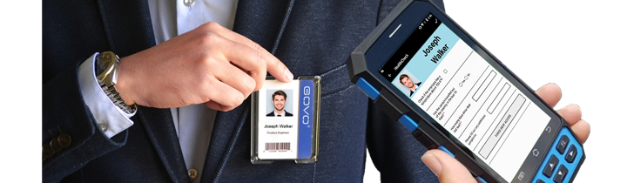
Mobile Security Solutions
Sales Presentation

Slide 2
20+ COUNTRIES
WORLDWIDE LEADER IN
HANDHELD EMPLOYEE VALIDATION
25+ OEM INTEGRATIONS
15+YEARS OF EXPERIENCE
500+ AWARDED PROJECTS
5,000,000+ RFID TAGS SOLD
10,000,000+ EMPLOYEES TRACKED

Slide 4
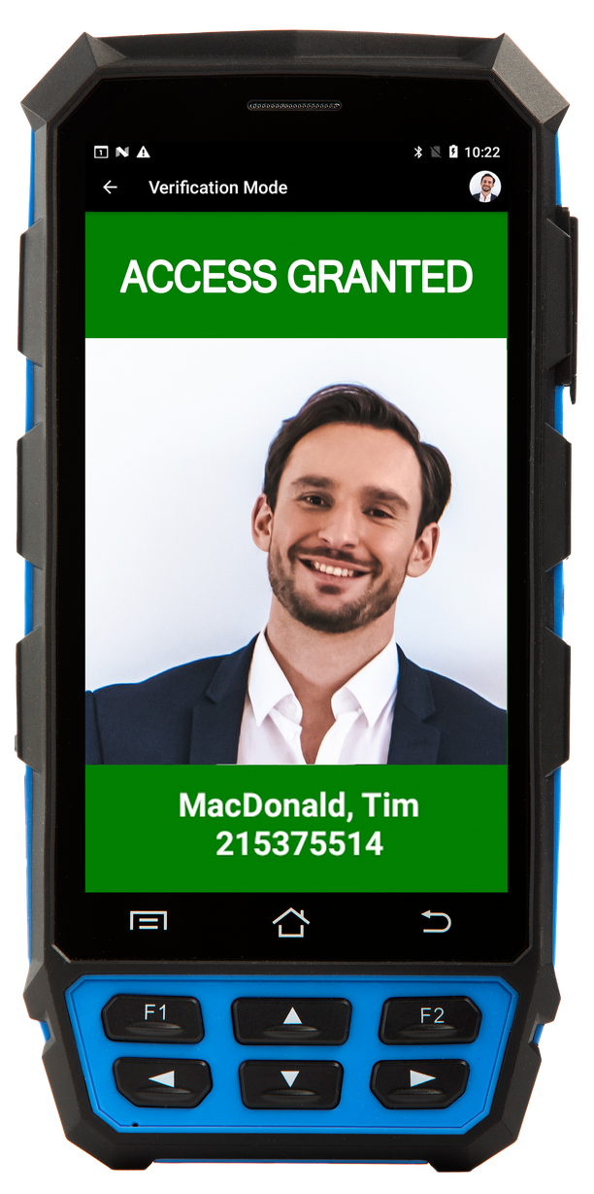
VISITOR
MANAGEMENT
EMPLOYEE
VERIFICATION
BIOMETRIC VALIDATION
ENTRY/EXIT TRACKING
ONE SYSTEM. MANY APPLICATIONS.
EMERGENCY
MUSTERING
EVENTS AND TICKETING
HEALTH
CHECK
BUS ENTRY VALIDATION

Slide 5
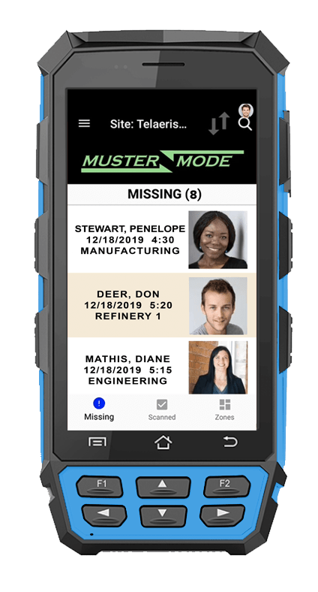
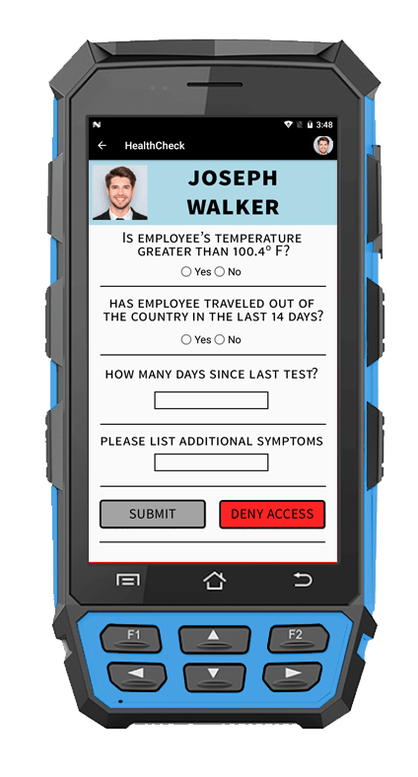
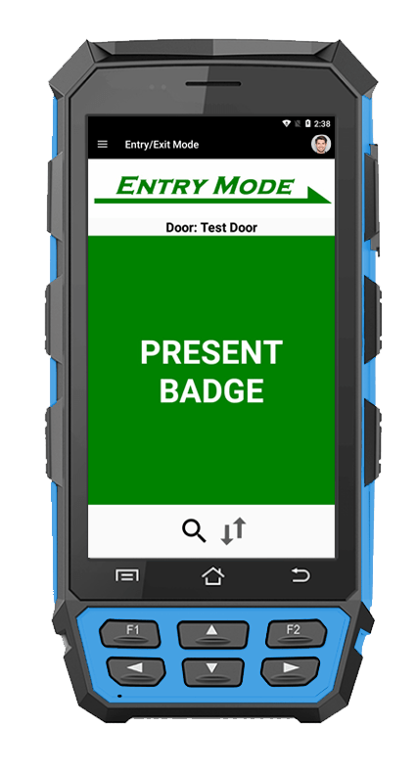
OUR PRODUCTS PROMISE:
Excellent customer service
Superior Product quality
Comprehensive solution
Compatible with any PACS system

Slide 6
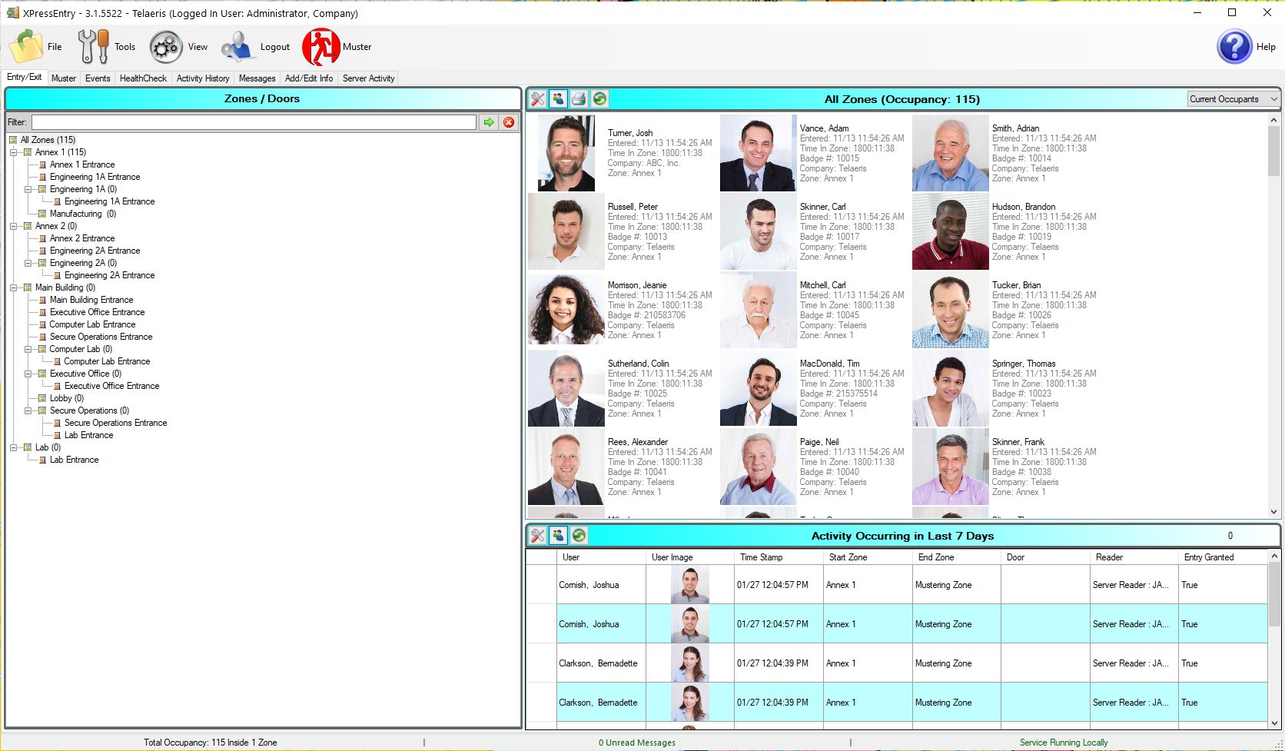
SERVER SOFTWARE
ENTRY/EXIT
MUSTER MODE
ACTIVITY HISTORY
REPORTS

Slide 7
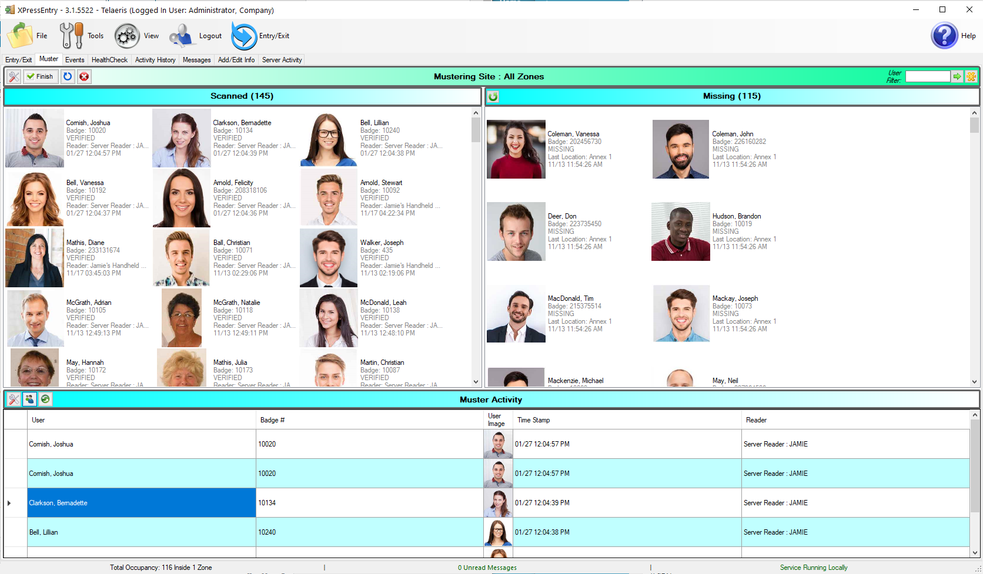
SERVER SOFTWARE
ENTRY/EXIT
MUSTER MODE
ACTIVITY HISTORY
REPORTS

Slide 8
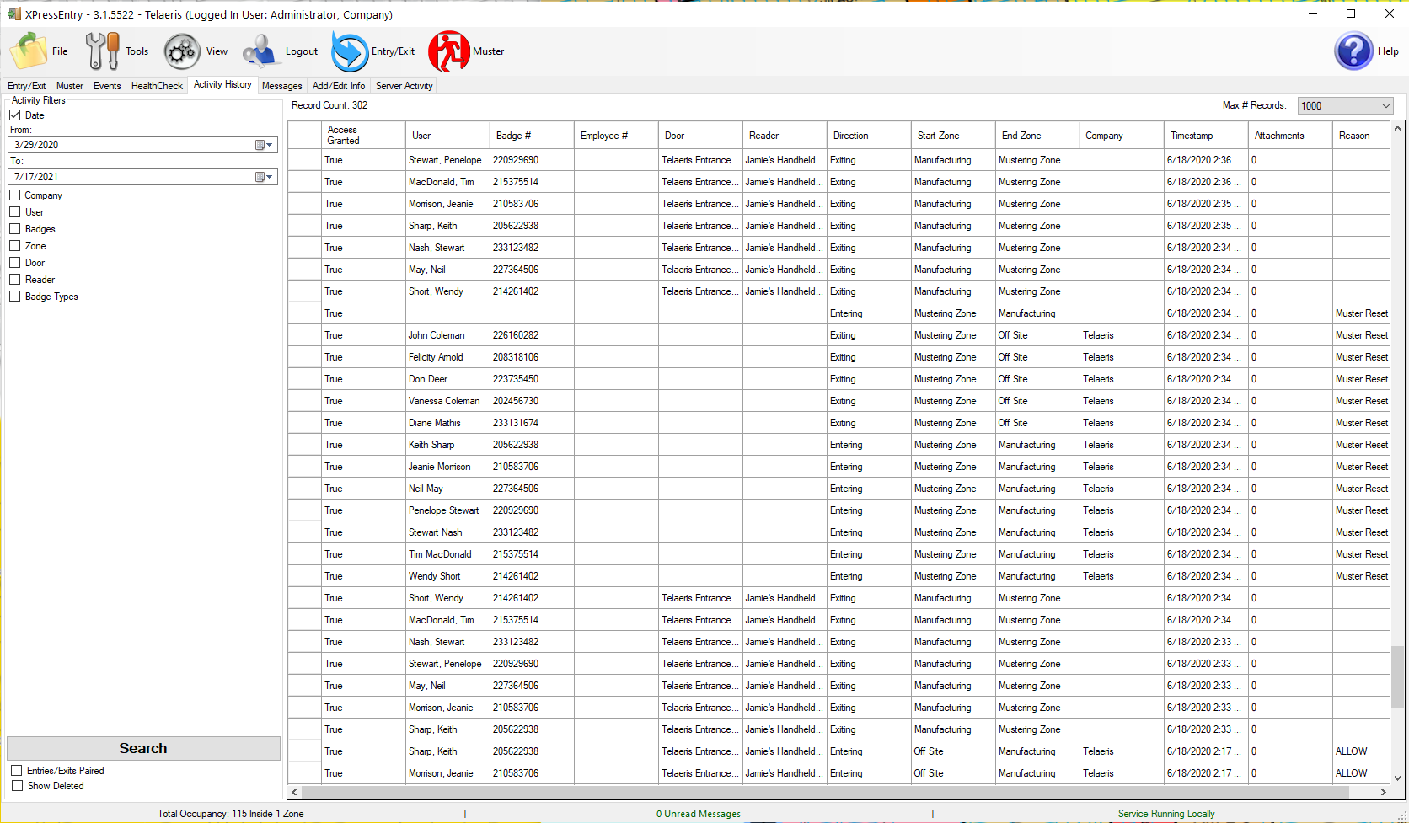
SERVER SOFTWARE
ENTRY/EXIT
MUSTER MODE
ACTIVITY HISTORY
REPORTS

Slide 9
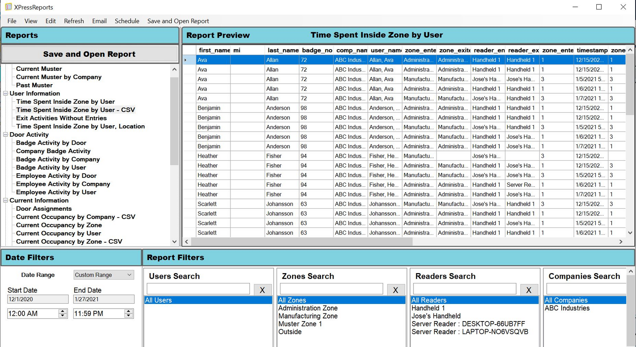
SERVER SOFTWARE
ENTRY/EXIT
MUSTER MODE
ACTIVITY HISTORY
REPORTS

Slide 10
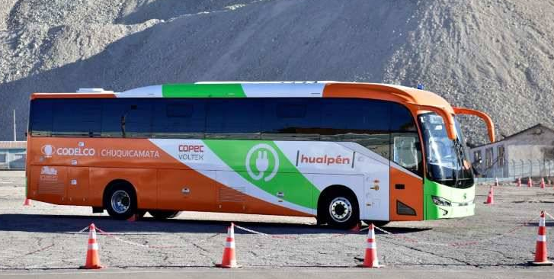
EXCELLENT
CUSTOMER
SERVICE
THANK YOU FOR CONSIDERING
Jose Flores, V.P., Sales
Telaeris, Inc.
9123 Chesapeake Dr., San Diego, CA 92123
Phone: 619-666-0315
E-mail: jose.flores@telaeris.com
linkedin.com/company/telaeris-inc/
facebook.com/telaeris
youtube.com/user/telaeris
twitter.com/telaeris

Slide 11
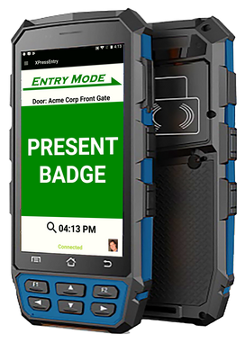
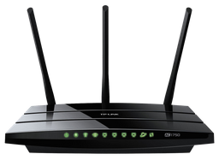
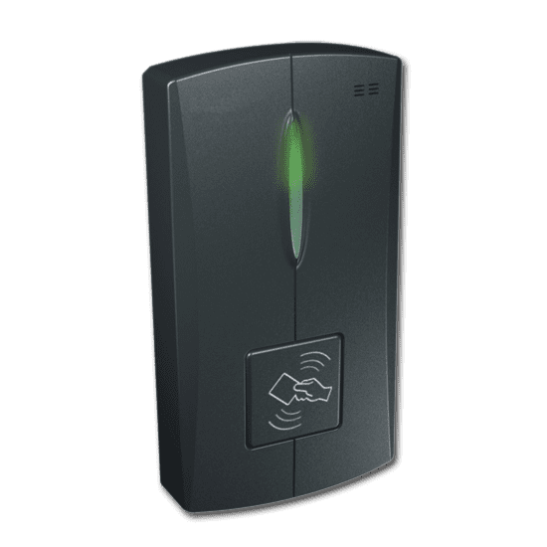
APPENDIX 1 - NETWORK ARCHITECTURE
PACS
HANDHELDS ALSO SUPPORT VPN
TO ACCESS CORPORATE LAN DIRECTLY
DATABASE SERVER
SERVER
DIRECT NETWORK
CONNECTION
ACCESS
PANELS
MIFI GPRS HH WIFI TO CELL
DIRECT NETWORK
CONNECTION
PORT 30000/30001
(CONFIGURABLE)
4G/5G CONNECTION
CORPORATE LAN
ETHERNET WAN
CORPORATE LAN
ETHERNET WAN

Slide 12
APPENDIX 1 - NETWORK ARCHITECTURE
PACS
HANDHELDS ALSO SUPPORT VPN
TO ACCESS CORPORATE LAN DIRECTLY
DATABASE SERVER
SERVER
DIRECT NETWORK
CONNECTION
ACCESS
PANELS
MIFI GPRS HH WIFI TO CELL
DIRECT NETWORK
CONNECTION
PORT 30000/30001
(CONFIGURABLE)
4G/5G CONNECTION
EMERGENCY MODE
PACS OFTEN BACKED UP AT REMOTE SOC,GSOC OR DATA CENTER TO PROTECT DATA IN CASE OF LOCAL NETWORK FAILURE
CORPORATE LAN
ETHERNET WAN
CORPORATE LAN
ETHERNET WAN

Slide 13
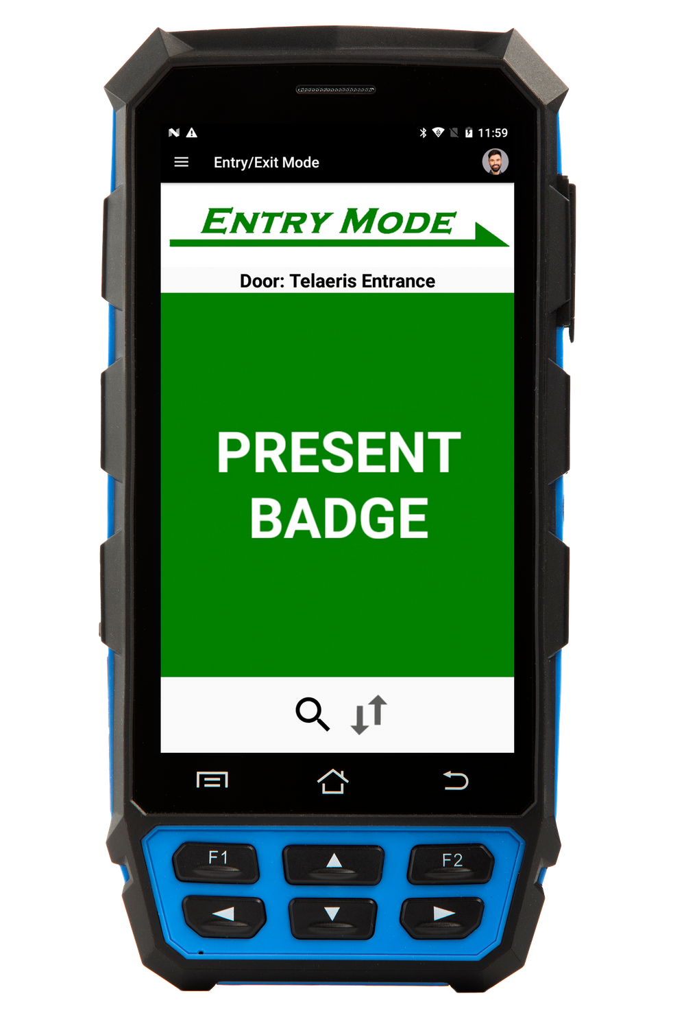
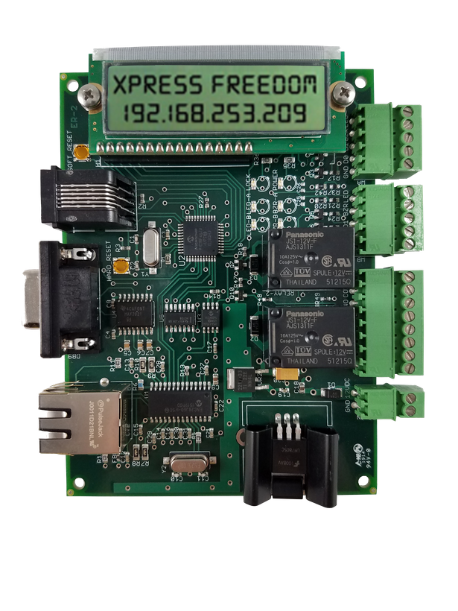
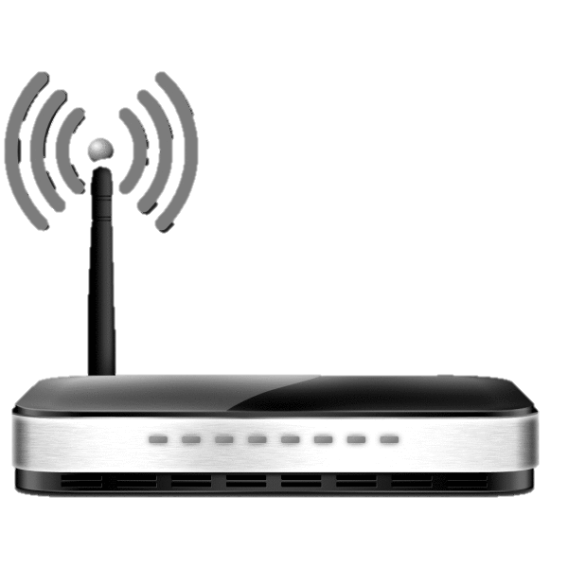
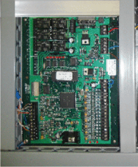
APPENDIX 2 -
ETHERNET DATA
WIEGAND SIGNALS
VERIFYING
BADGE
WIRELESS DATA LINK
AUTHENTICATION
AUTHENTICATION
CONVERTS ETHERNET DATA TO WIEGAND SIGNALS

Slide 14
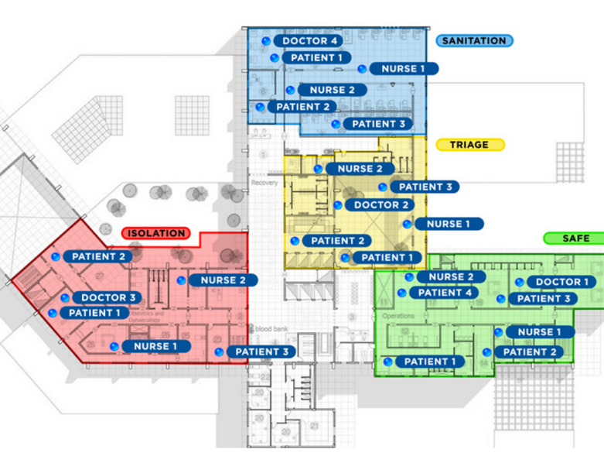
APPENDIX 3 - RTLS
Continuously track the LOCATION of all employees in REAL TIME

Slide 15
APPENDIX 4 - INSTALLATION PREREQUISITES
FOR MORE INFORMATION:
500+
Installations and counting
https://telaeris.com

Slide 16
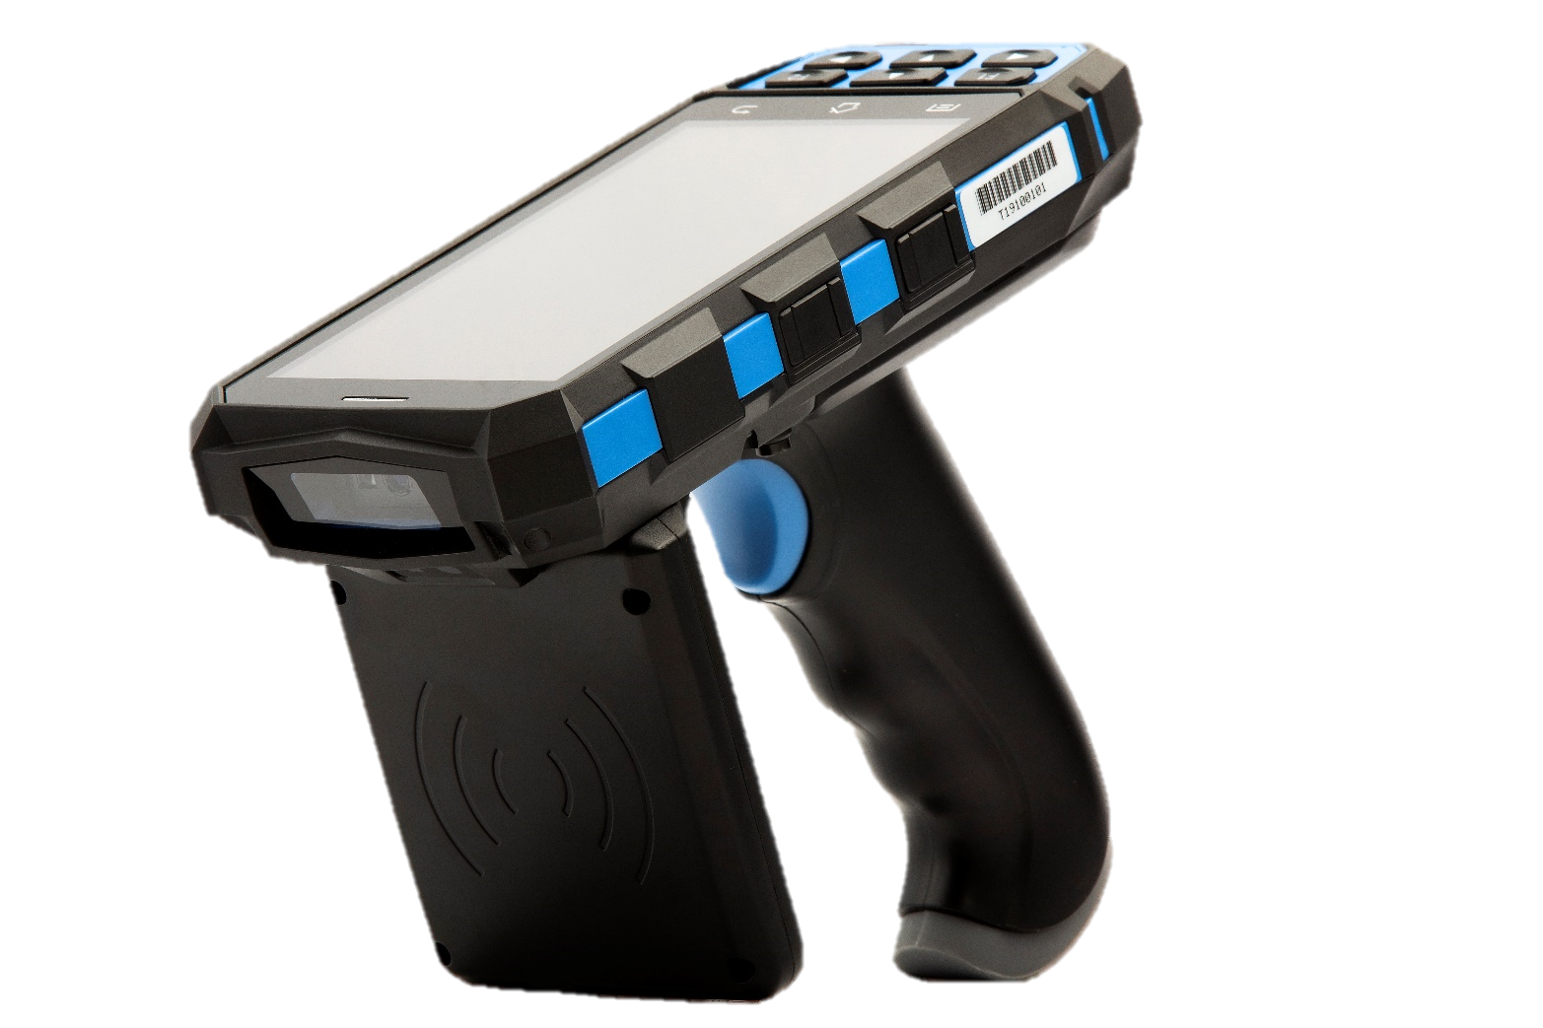
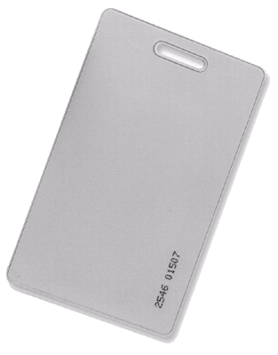
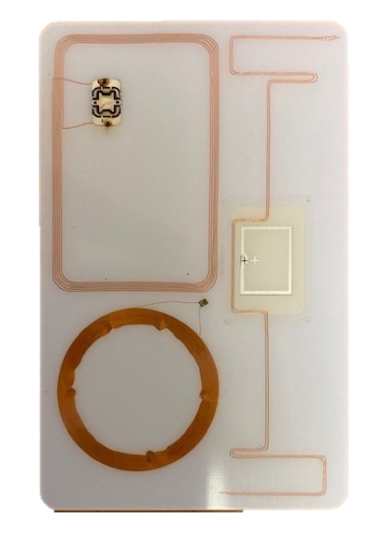
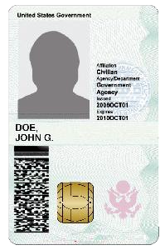
APPENDIX 5 - CARDS
PIV
MIFARE
HID PROX
DESFIRE
ICLASS
LEGIC
ICLASS
SE
CASI-RUSCO
3 – TECH UHF/HF-NFC/LF
FARPOINTE
ISO 14443
INDALA
ISO 15693
BLE/ACTIVE
SECURA KEY

