Slide 1
Reliable and secure products
BSTsecurity enables you to experience SAFETY at high quality and
mid-range prices.
17550 Route Trans Canadienne, Kirkland, Quebec, Canada H9J 3A3

Slide 2
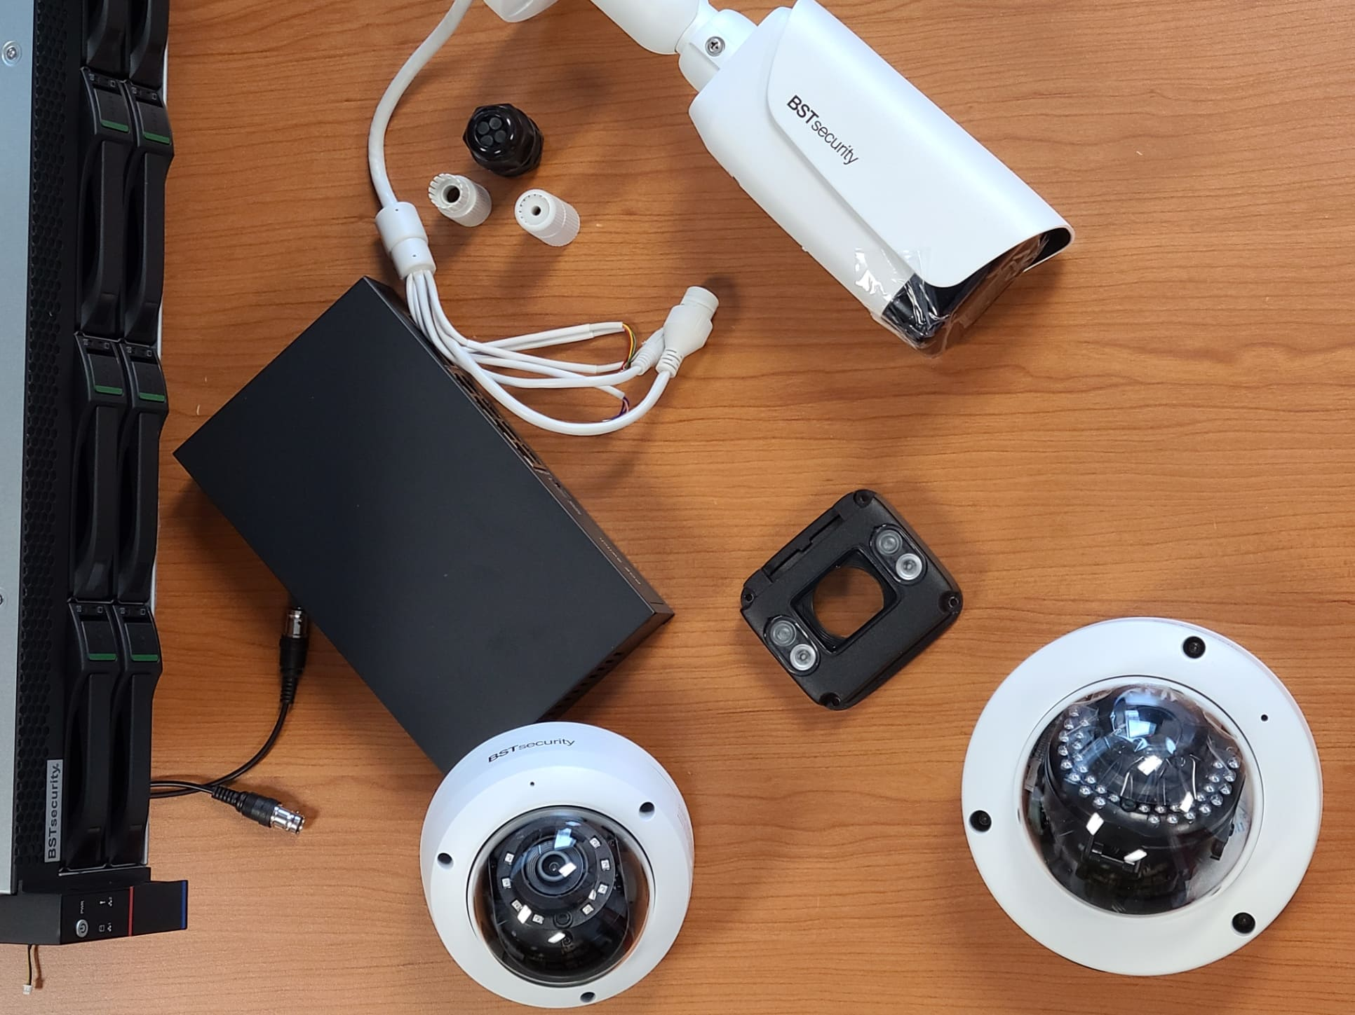
The Company
BSTsecurity is a Canadian-based company founded in 2012 and is actively engaged in the security surveillance industry, specifically the development of security surveillance solutions (CCTV cameras and VMS).
BSTsecurity started its operations in the security industry to satisfy the need for an advanced security platform ( integrated solutions) at competitive pricing. To offer security clients and integrators its comparative advantage and value propositions (virtual perimeter/ object detection/ thermal) and serve local and international markets (US/ Canada/ Middle East/ Europe).
With the continuous innovative addition of products, the company has aggressively moved to the front of the industry by focusing its resources on the manufacturing and developing CCTV security solutions for Industrial, commercial, Institutional, and enterprise-level clients.
BSTsecurity is committed to build and shape a safe security surveillance solution platform through the innovative development of high-quality products that exceed clients' specific and customized security needs in an ever-evolving industry.
Mission Statement
“BSTsecurity is committed to build and shape a safe security surveillance solution platform through innovative development of high-quality products that exceed clients specific and customized security needs in an ever-evolving industry ”.
BSTsecurity ©

Slide 3
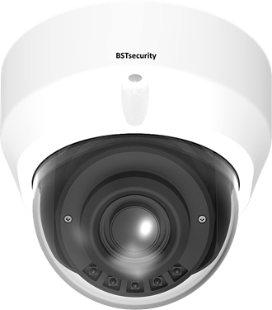
In an industry that is seeing technological innovation and advancement,
the set of products offered by the different companies are more and more sophisticated where intelligent video surveillance solution provides assessment capabilities and situational awareness at each layer of the integrated security system. Hence the consumer whether a small enterprise or large one is shifting from basic solutions and focusing on taking full advantage of the combined benefits of all in one solution. One challenge in the industry is being able to offer customers more for less and that is exactly where BSTsecurity can excel by constantly upgrading itself in order to gain a competitive advantage over other players.
THE TECHNOLOGY
The technology in surveillance solutions, Hardware and software, have drastically improved over time offering more advantages to businesses and enterprises. Achieving the benefits of advanced surveillance solutions requires the right mix of supporting technologies. BSTsecurity is concentrating its effort and research to update its products in an effective and efficient manner focusing on a shift toward proactivity in increasingly integrated sensing and feeds processing complimented by robust components which creates an autonomous surveillance solution.
BSTsecurity ©

Slide 4
Examples includes:
Low light Camera solution for night vision producing a high dynamic range image with few light photons. Equipped with enhanced lighting to capture images, better optics, improved algorithms and advanced sensors, low light cameras can create crystal clear video with vivid detail, even in total darkness.
Camera Hardware to handle extreme weather conditions: -40 ~ +70 degrees Celsius. Operating in the most adverse environments, BSTsecurity is taking weather protection to the next level with surveillance systems that will best stand up to inclement weather, using the Ingress Protection enclosure IP67.
Footage recording devices with the lowest market compression and massive petabytes of storage: Data storage plays a new and vital role in the security surveillance industry with regulations and requirements getting more and more sophisticated, as enterprise storage systems are starting to leave the terabyte behind, moving into petabytes. Therefor BSTsecurity has implemented advanced video data compression known as H.265, to reduce HD streams to around 1Mb/s and produce a 4k compressed stream of around 4Mb/s, lowering the bandwidth and preserving a very high image quality, while staying completely aligned with the existing enterprise resources and infrastructure.
BSTsecurity ©

Slide 5
AI Camera analytics such as tripwire object detection identification and classification. The development of artificial intelligence (AI) has aided its adoption in several industries, and the security market is increasingly looking to adopt AI applications, particularly in the case of deep learning algorithms in the video surveillance market, creating organizational efficiencies and tools that automate security alerts and make it easier to respond to threats in real time, flag unusual activities, and identify faces in crowds. This advanced security need is becoming a big part of the solutions and advantages where BSTsecurity can compete in technological advancements.
BSTsecurity will be one of the first few manufacturers in the CCTV field to present a new game-changing security camera development concept consisting of the industry-standard open OS while preserving a high standards and specifications for the operating system, IoT infrastructure, and a collective approach for data security and privacy. This will differentiate the solutions we offer in a flooded market where we are witnessing a growing demand for smart video surveillance. This new innovation is based on IoT (The Internet of Things) meaning connecting network-enabled devices and exchanging data between them, it offers great potential for improving processes wherever information needs to be exchanged securely and quickly. It enables devices and adds much more value than they have had so far. For this, there is no better example than security cameras.
BSTsecurity ©

Slide 6
BST-PEHD series
(using Video Analytics software Technologies)
Intelligent control of PTZ cameras
The BST-PEHD system offers an advanced video intelligence solution for surveillance of outdoor areas using PTZ and stationary cameras.
With a proprietary technology called
«MultiTrack», the BST-PEHD controller uses video analytics to detect various types of moving objects on fixed cameras. From the detections, it drives a motorized PTZ camera to follow and zoom on objects of interest to capture close-up images that can facilitate the identification of persons or vehicles.
BST-PEHD offers an ideal solution for monitoring large outdoor areas by providing an active and autonomous mean to control PTZ cameras, without the intervention of an operator.
Mode Multi Track
In Multi Track mode, fixed cameras are used to detect and analyze objects in the area under surveillance. From this detection, the Pan/Tilt/Zoom camera is driven to track and zoom on objects of interest. Priorities can be configured based on object types and based on areas of interest. One PTZ camera can work in collaboration with up to fifteen fixed cameras to monitor a large outdoor area.
Based on a powerful processor and product design, BST PEHD supports multiple simultaneous operations.
BST-PEHD series is a powerful networked security solution with intelligent video analytics, delivering IP video monitoring surveillance. With an easy and simple configuration of IP cameras and programming setup, it allows users comfortably and gradually to transit from analog cameras to IP cameras.
Video Analytics
In addition to detecting and classifying moving objects, BST-PEHD uses video analytics to increase the reliability of detection in contexts of remote or alarm central surveillance. Intelligent filters and special functions enable to reject most false detections caused by light reflections, oscillating trees, and other outdoor phenomena. Moreover, a specific function enables to designate “passage zones” where priority zooming enables to capture systematically close-up images of license plates or pedestrian faces.
Object Detection
Moving objects in the view area are detected and classified under three categories: persons, vehicles and other objects. These detections are used to control PTZ cameras, trigger recording and send alarms signals.
Remote Access
The BST-PEHD system offers a complete remote access software client based on Windows. Remote live view is also available for iPhone smartphones and iPad tablets.
BSTsecurity ©

Slide 7
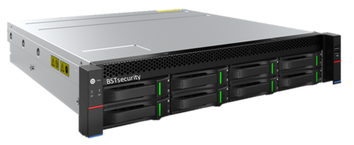
BST-4000 series
Playback & Backup:
Synchronized Playback
Search Mode: Time/Date/Alarm
Playback Function: Play, Pause, Stop, Rewind, Fast play, Slow play, Next file, Previous file, Next camera, Previous Camera, Full screen, Repeat, Shuffle, Backup selection, Digital Zoom( any size)
Backup Mode: Flash drive/USB HDD/ USB CD&DVD-RW/e SATA Device/Built-in SATA burner/Network download
(reliable high performance stability and cost effective)
The ECV4000 series offers quality and stability for optimum profitability, thanks to its high-performance microprocessor. Designed for small to mid-sized applications, it offers a variety of features including Smart Search, Intelligent Recording System, Penta-Plex (Live Recording, Playback, Backup and Remote Access). It also simplifies camera installation with simple plug-and-play. The ECV4000 series supports the intelligent analysis process up to 80 channels optimized by its structure: it performs several operations while the system monitors and records.
Network & Auxiliary Interface
Ethernet: RJ-45 port(10/100M)
Network Function: TTP,TCP/IP,UPNP,RTSP, UDP,SMTP,NTP,DHCP,DNS,IP Filter, PPPOE, DDNS, FTP, Alarm Server, IP search
Remote Operation: Monitor, PTZ control, Playback, System setting, File download, Log information.
USB Interface: 2 USB2.0 ports for mouse control & backup
RS232: Keyboard, PC communication
RS485: PTZ control
Features
Up to 40 ch Hot swap HDD
live view, storage, and playback up to 12MP resolution
HD Output
HDMI and VGA independent outputs
HDMI Video output at up to 4K (3840× 2160) resolution HD Storage
8 SATA interfaces connectable for recording and backup, up to 10TB for each HDD
2 self adaptive 10/100/1000 Mbps network interfaces
VCA detection alarm
Smart search and playback
Recording:
Decoding Format H.265/H.264
Recording Resolution 12MP/8MP/6MP/5MP/4MP/3MP/ 1080 P/UXGA/720P/VGA/4CIF/DCIF/2CIF/CIF /QCIF
Preview 3× 12MP, 4 × 8MP, 4 × 6MP, 5 × 5MP, 8× 4MP, 9 × 3MP, 16 × 1080P, 32 × 720P, 40× 4CIF
Synchronized Playback 3× 12MP, 4 × 8MP, 4 × 6MP, 5 × 5MP, 8× 4MP, 9 × 3MP, 16 × 1080P, 16 × 720P
BSTsecurity ©

Slide 8
BST-ECV4080 and BST-ECV40160 H.265/264 240TB Hot Swap - Raid NVR
Features:
• Up to 12MP Resolution Recording
• Up to 160 ch Intelligent Analysis Process
• JBOD,RAID0,RAID1,RAID5,RAID6,RAID10
RAID50, RAID60
• HDD Quota and Group Management
• 4X 100/1000Mbps Self adaptive Ethernet Interfaces,
4 1000Mbps optical port
• Throughput in/out 960Mbps/480Mbps
• ANR Function
• N+M Hot Standby Function
• 24 SATA, Alarm I/O 8 /4, Audio I/O 1/1,
4x USB,2x RS 485, 1x RS 232
• 2x HDMI, 1x VGA, Different Video Source,
Max Resolution 4K
BSTsecurity
This unit has already proven itself in many commercial multi-projects and residential towers around the world, but was previously available only as a special order for large projects. It has 120 days of real-time 24/7 recording at least 1080p 15FPS (No Motion ) often on hundreds of cameras in the same place. Multiple units can be used together to manage and register hundreds of cameras on the same system and integrate simultaneously with Galaxy Controls Access Systems and others.
BSTsecurity ©

Slide 9
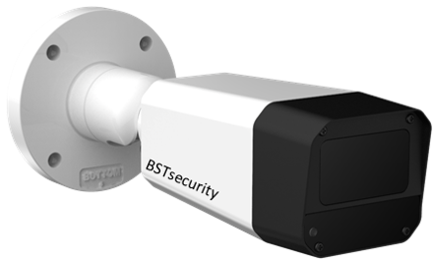
Based on the Azena ecosystem, that connects an operating system with our customized apps BSTsecurity provides cameras paired with advanced AI applications and equipped with powerful SoCs, enabling faster, cheaper, more reliable, and GDPR-compliant data processing, generating new insights by running multiple AI-based apps on a single camera, or run multiple apps on different cameras, allowing the flexibility of adding new ones over time and re-equipping cameras whenever required.
Using the Azena IoT solutions as a base for the new trends in modern security cameras enables analyses to be performed directly on the devices based on strong computing power. It also decreases the installation costs by having the connection to the Internet carried out at ever higher transmission rates, and most importantly, it develops algorithms from AI and Machine Learning to form the basis of completely new applications.
Access to uncompressed video pipeline allows for better analytics results
Low network bandwidth required, no latency issues
Less network infrastructure required results in lower solution costs
Allows for data privacy (GDPR compliance)
So how this camera can reduce your system cost compared to server-based solutions:
With multi-purpose deployment capabilities, cameras can simply be re-equipped and re-purposed to follow your changing surveillance requirements without the need to change the cameras themselves.
App analytics embedded in the camera can lower your costs compared to most server-based solutions.
Server's computing is replaced with edge computing directly from the camera.
Low maintenance costs due to remote camera access.
Applications:
Commercial buildings
Railway and Metro
Healthcare
Retail
Traffic and parking
Manufacturing
Stadiums
Helping you grow your business
www.bstsecurity.com

Slide 10
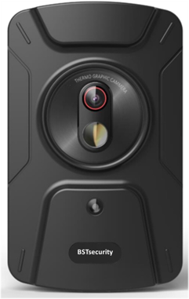
BST-E1612MW Dual Screening Body Temperature Camera
BSTsecurity Thermal cameras are designed to be integrated into full smart access security solutions, used in combination with both visual video analytics and thermal sensing.
Skin temperature screening represents an important part of the thermal camera application based on the demand from integrators and end-users from different sectors such as commercial office buildings, transportation and government facilities who are looking to deploy thermal camera solutions.
AI algorithms can also be integrated as facial detection in the camera software to help recognize individuals with high skin temperature in a crowd.

Slide 11
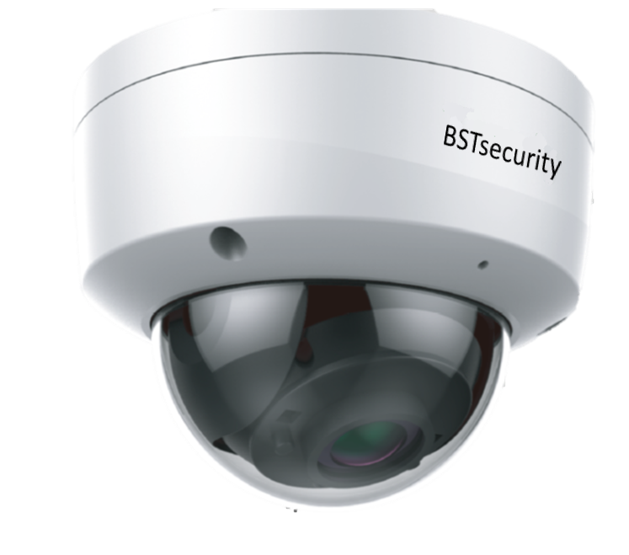
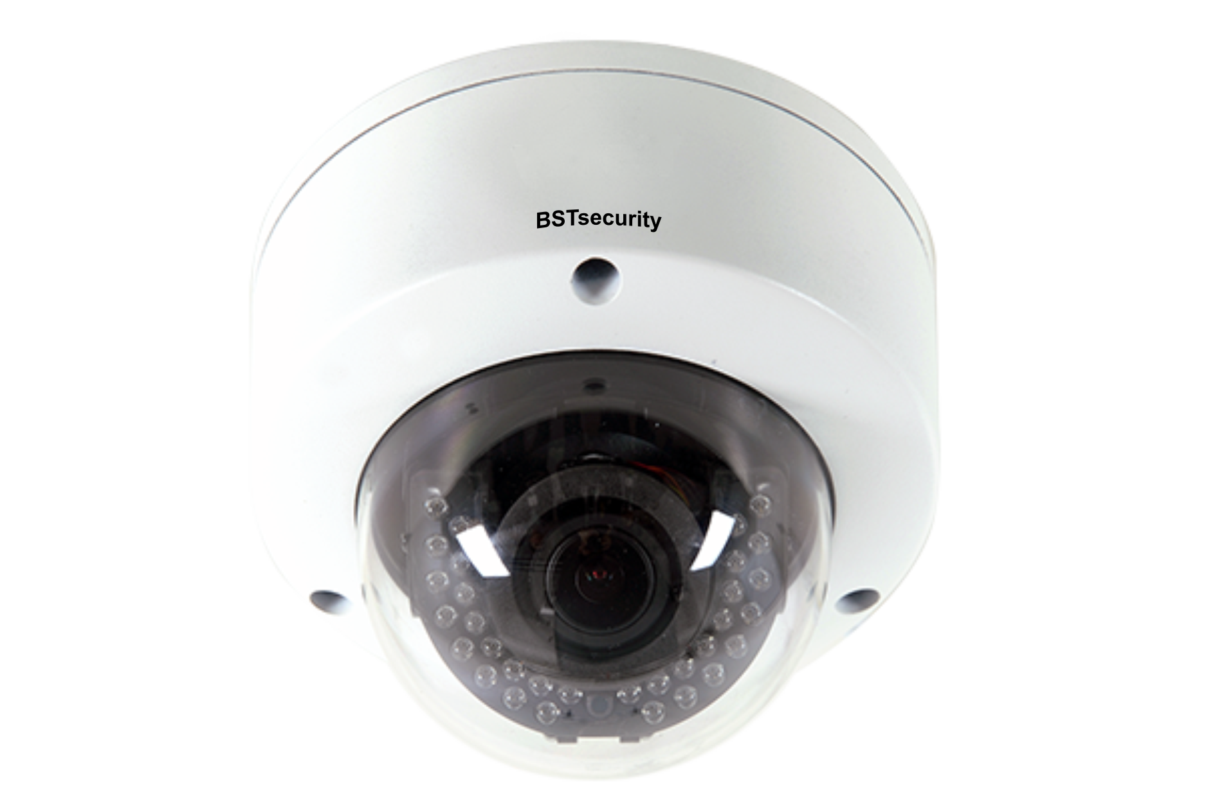
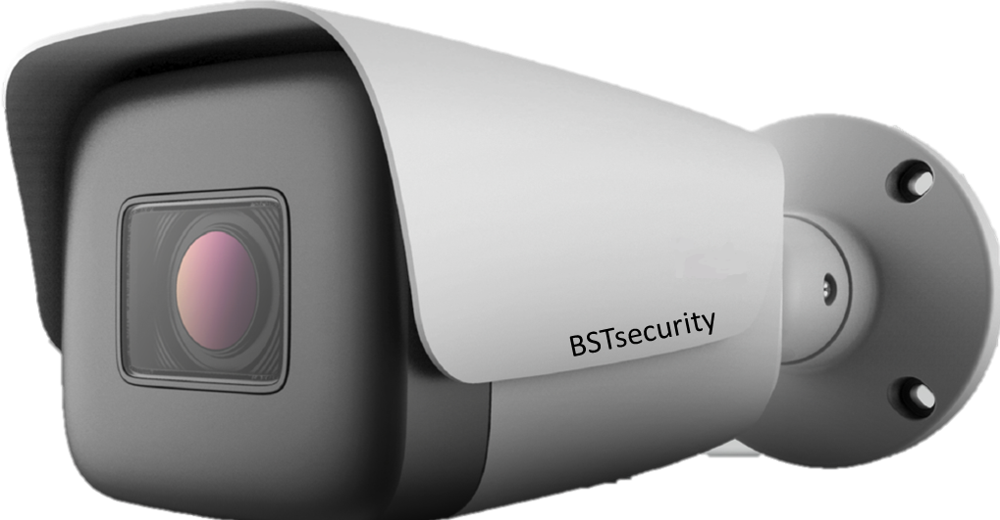
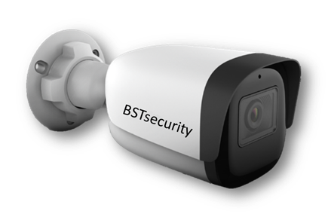
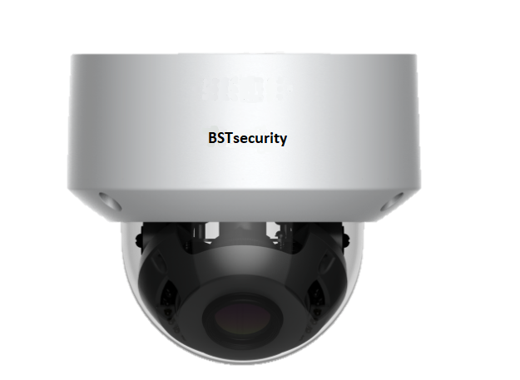
BST-DF905IR25
5MP Starlight Vandal proof Mini IR Dome Camera, H.265 Compression, WDR 120dB, IR Range: 10-15m, IP66
PRO SERIES
IK10
IP66
IP67
BST- DT905IR-M
5MP H.265 Varifocal IR 2.7~13.5mm Dome Camera, 5MP@30fps, varifocal Motorized lens, ICR, WDR, Auto focus
BST- BT905IR-M
5MP Starlight Motorized lens 2.7~13.5mm IR Bullet Camera, WDR,POE, IP67
BST- BF905IR25
5MP Starlight IR Mini Bullet Camera, H.265 Compression, WDR 120dB, IR Range: 20m, IP67
BST-DT9102-MS
2MP Motorized Lens 2.7 13.5mm Vandal proof IR Dome Camera, Min. illumination Color: 0.001Lux@F1.6, WDR, POE, IP67, IK10
BST-BT9102-MS
2MP Motorized Lens 2.7~ 13.5mm Vandal proof IR Bullet Camera, Min. illumination Color: 0.001Lux@F1.6, WDR, POE, IP67, IK10
BSTsecurity ©

Slide 12
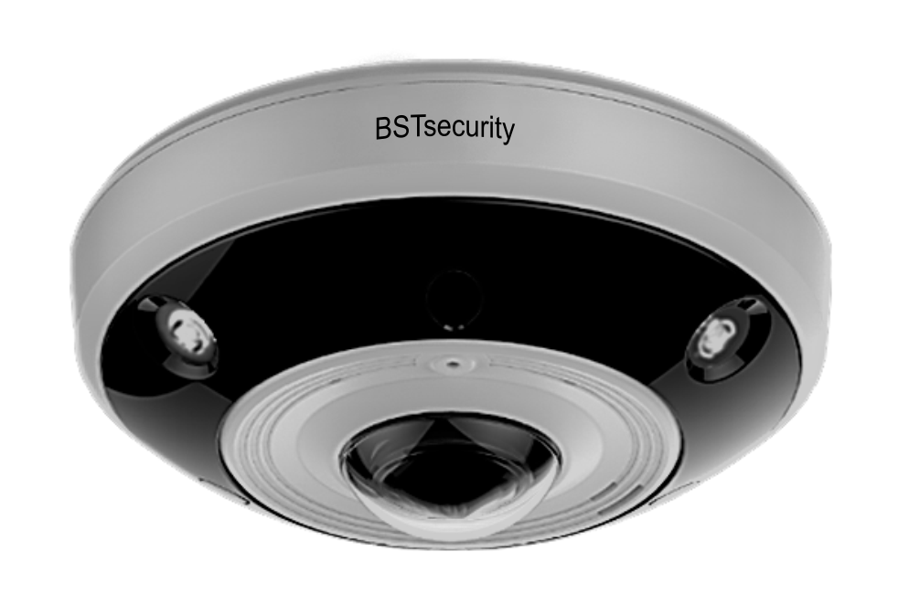
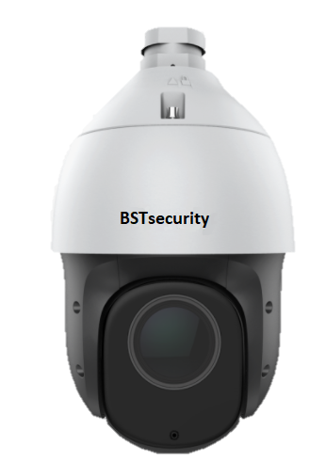
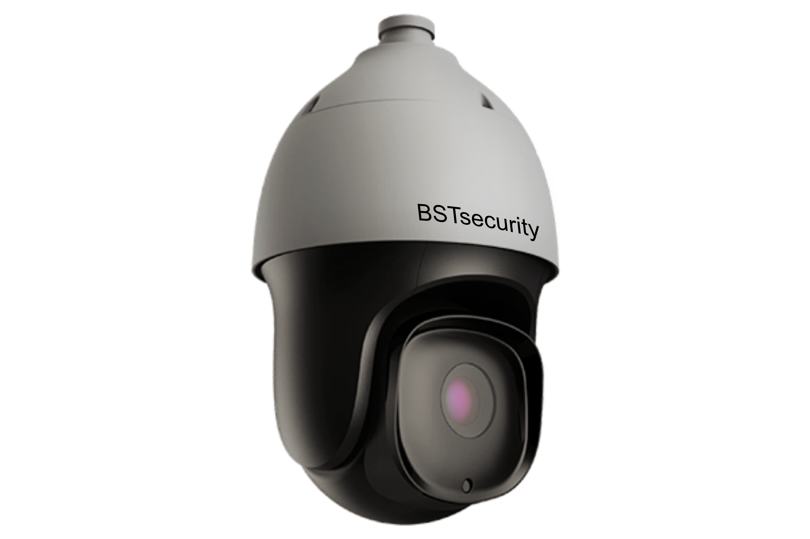
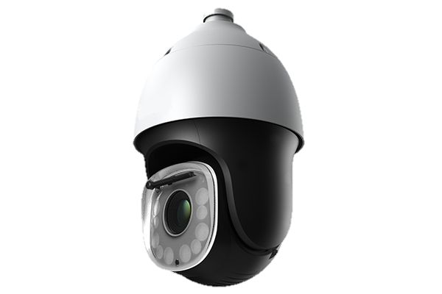
PTZ CAMERAS
BST-D12P360
12MP 360° Panoramic Fisheye Camera, Up To 4000 × 3072@20fps, H.265/H.264 HP/MP/BP/M-JPEG Codec
VCA Tripwire/Double Tripwire/Perimeter/Early Warning/Heat Map/Audio /Video Detection/Auto tracking, Min. Illumination Color: 0.01 Lux, B/W: 0.005 Lux, 0 Lux with IR, Up to 15m IR Range IP66,IK10
BST- 2MHSI-25X
H.265 2MP 25x Starlight POE IR PTZ, Up to 1920×1080@30fps
Mechanical WDR 140dB, IR Range: 100m, IP66
BST-2MHSI-33X
H.265 2MP 33x Starlight IR PTZ 2MP Full HD Speed Dome PTZ Camera, 1080p@30fps, 360°continuous pan rotation, IP66 - IK10, Mechanical WDR 140dB IR Range: 150m, Optical Zoom: 33x, NIR, WDR, 3D DNR, HLC, Dual-ICR, AWB, AGC, BLC
BST-2MHSI-44X
2MP 44x Super Starlight AEW IR PTZ, S+265/H.265/H.264, HP/MP/BP/M-JPEG Codec, Up to 1920×1080@60fps, Smart IR, IR Range: 400m, WDR 140db, IP66
BSTsecurity ©

Slide 13
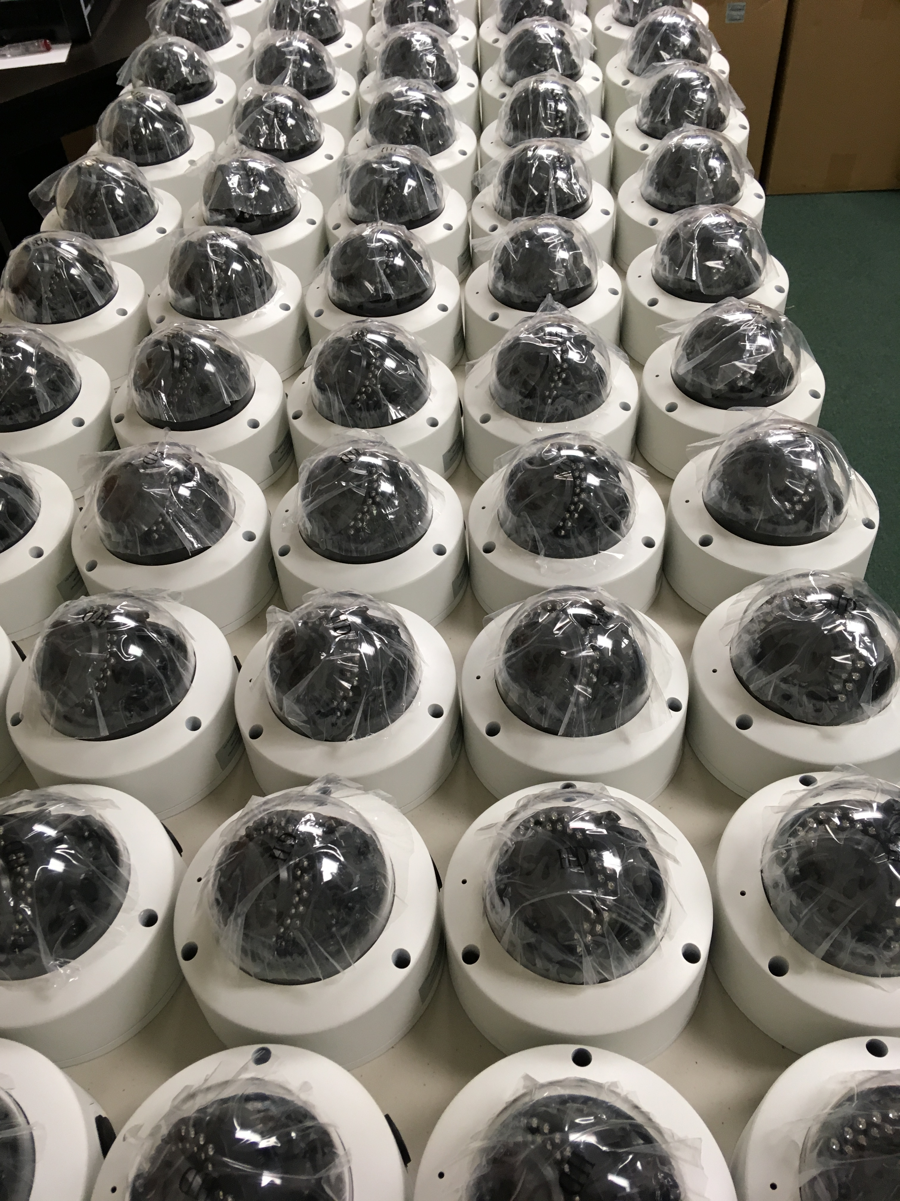
Product Development & Design
As CCTV solution developer, BSTsecurity engineers are continuously creating the most valuable environment for innovation in surveillance technology and are working on designing, innovating and reshaping its product lines. Our R&D department is always ensuring that BSTsecurity maintain its competitiveness by keeping an eye on developing trends within the surveillance sector whether by working towards enhancing pre-existing products or exploring new ones.
BSTsecurity ©

Slide 14
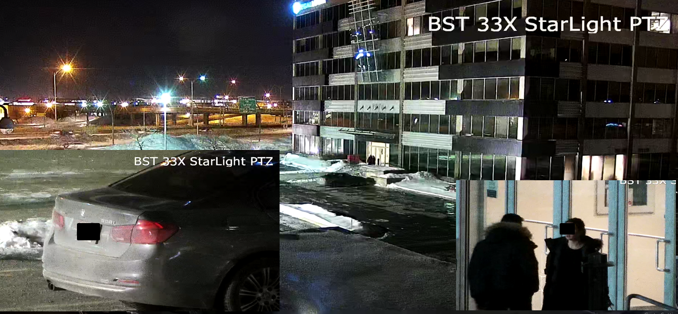
Sample Late Night at 200M -20C Bright Lobby Behind Subject and License Plate at 200M with NO IR and No enchantment (Raw Clip)
BST Starlight
Ultra WDR 33X
IP67/IK10 Speed Dome
BSTsecurity ©

Slide 15
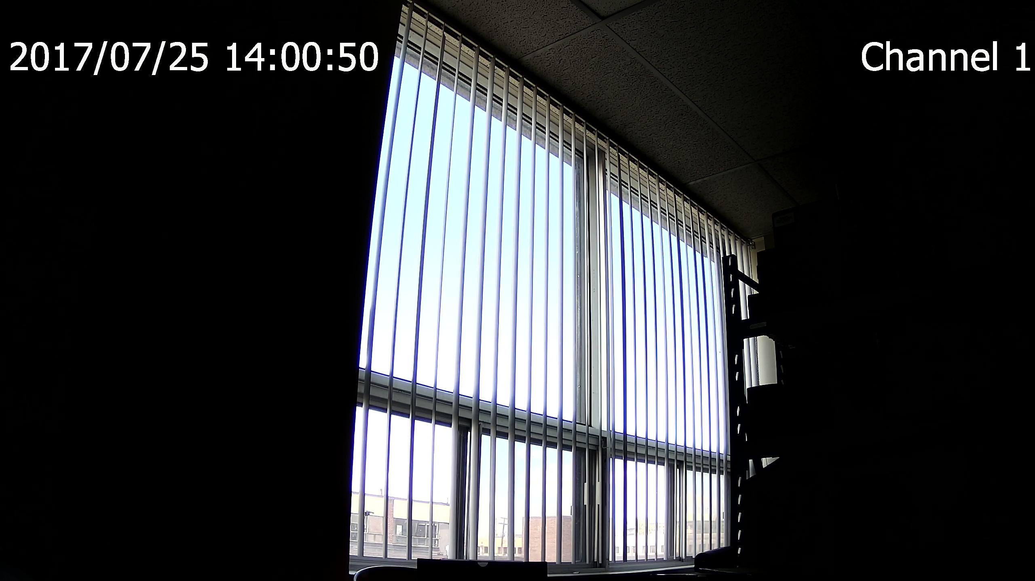
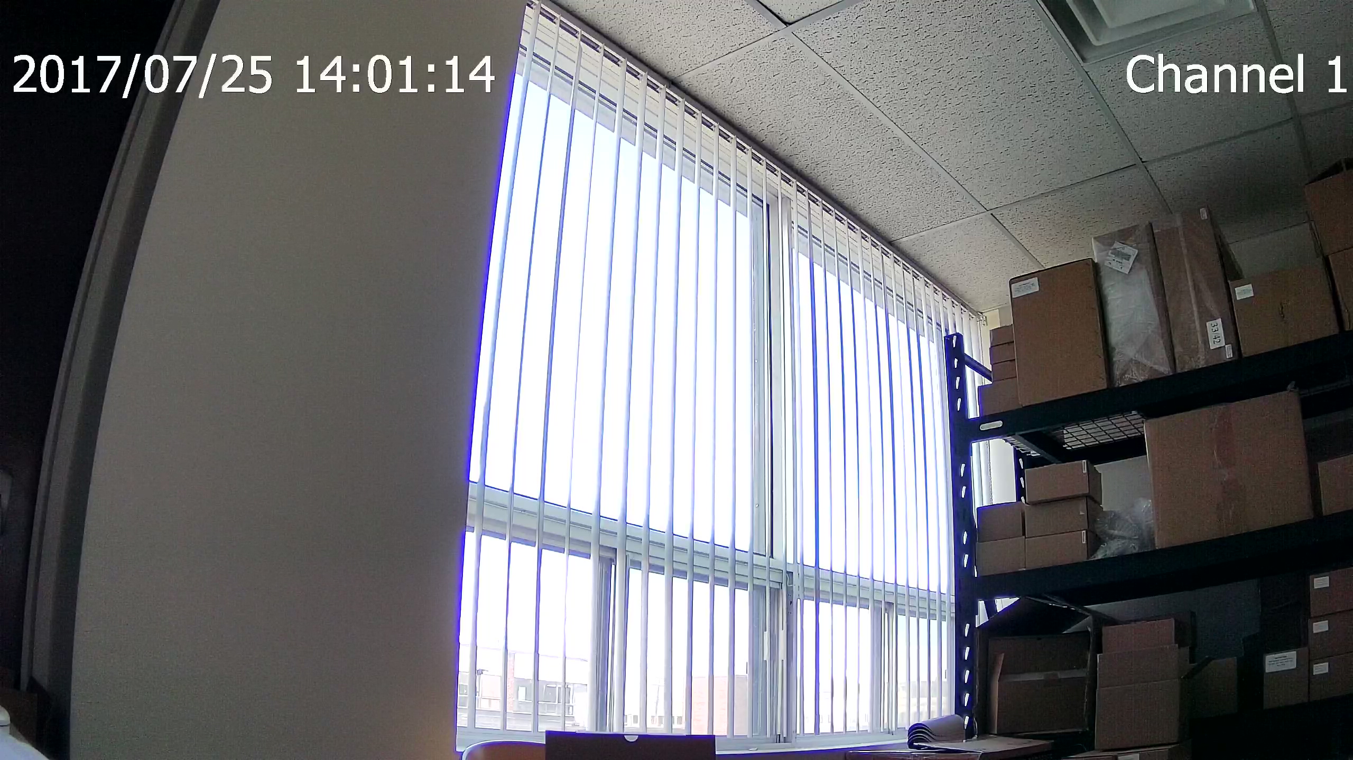
BSTsecurity Smart and Pro Series Ultra WDR with140db Sample of Window view on bright sunlit conditions (Raw Clip)
NO WDR
BST ULTRA WDR ON

Slide 16
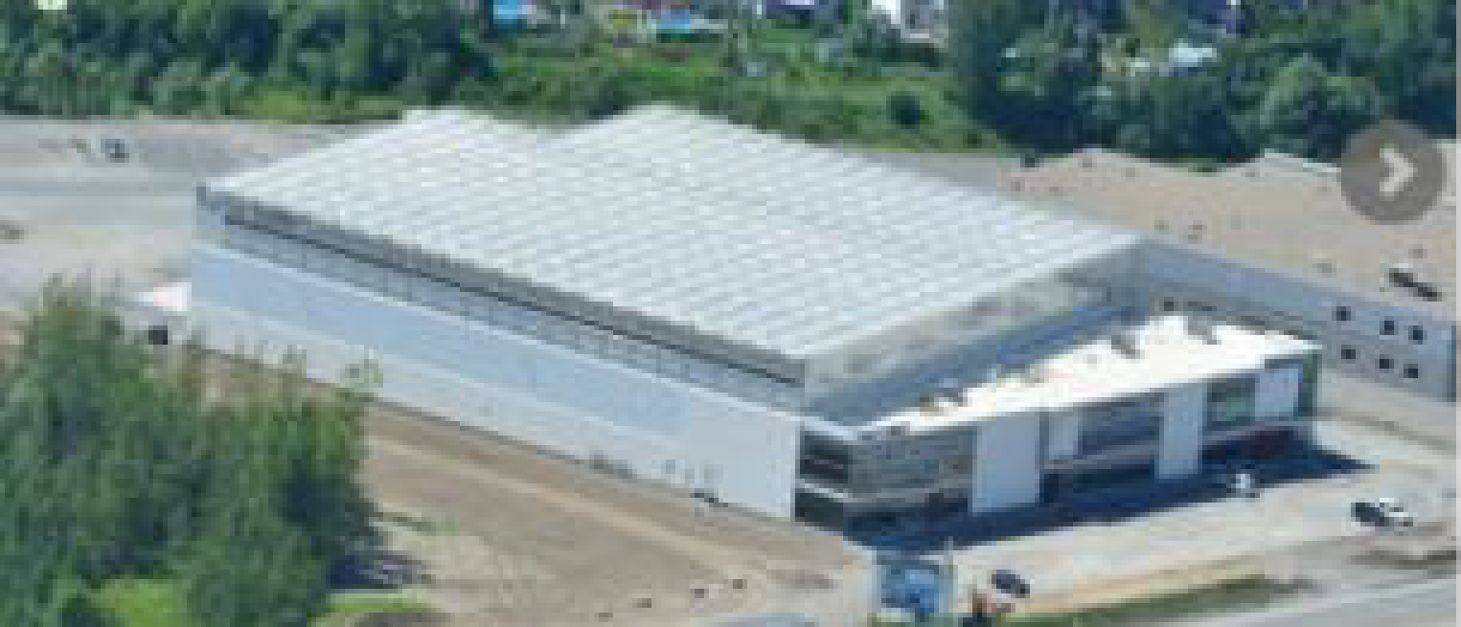
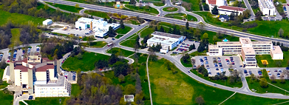
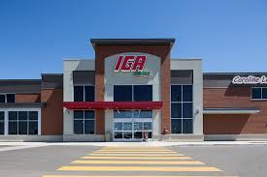
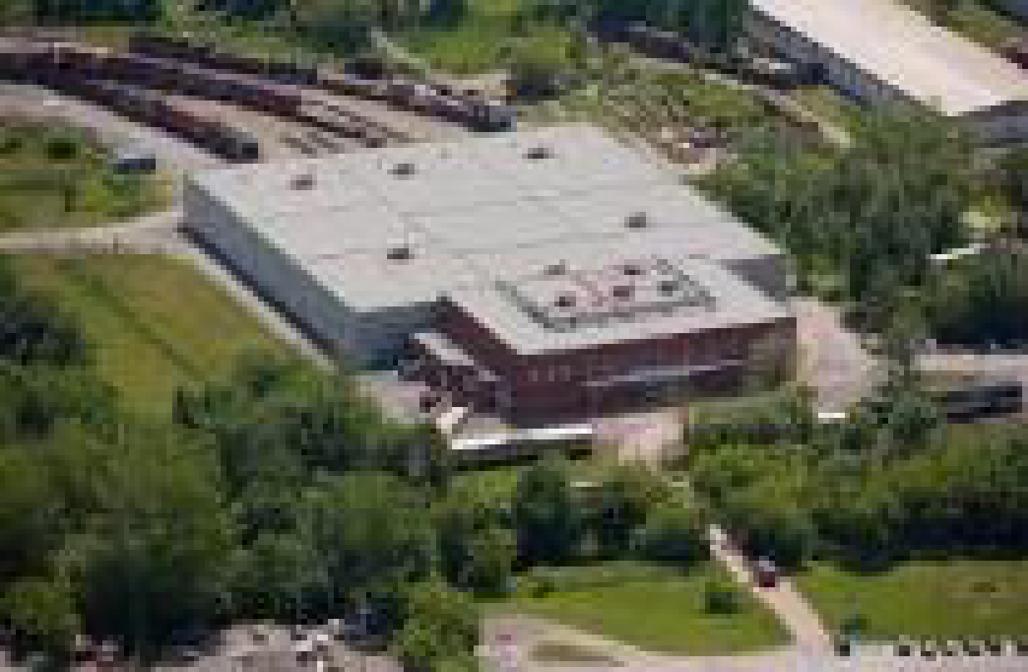
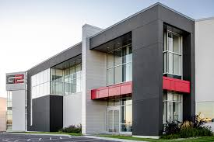
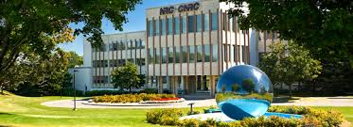
Projects with BST Designed Solutions
LufaFarm
North America projects:
Revenue Quebec
Exporail (Canadian Railway Museum)
National Research Council of Ontario - Canada
G2 Printing (Packaging and printing solutions for healthcare and cosmetic sectors)
Delilah (Fashion and Accessories 30 branches chain store)
SécuritéExpress (Regional Centralized Monitoring )
LufaFarm (The world's first commercial rooftop greenhouse)
The Jean Coutu Group Inc. (One of the largest Canadian pharmacy chain)
Pharmaprix (One of Canada's largest retail pharmacies)
Subway, Second Cup, Tim Hortons ( Multi-Branches)
IGA Supper Markets
Metro Plus Laval, Quebec
Towers Complex by Mathew Mathew
G2 Printing
Exporail

Slide 17
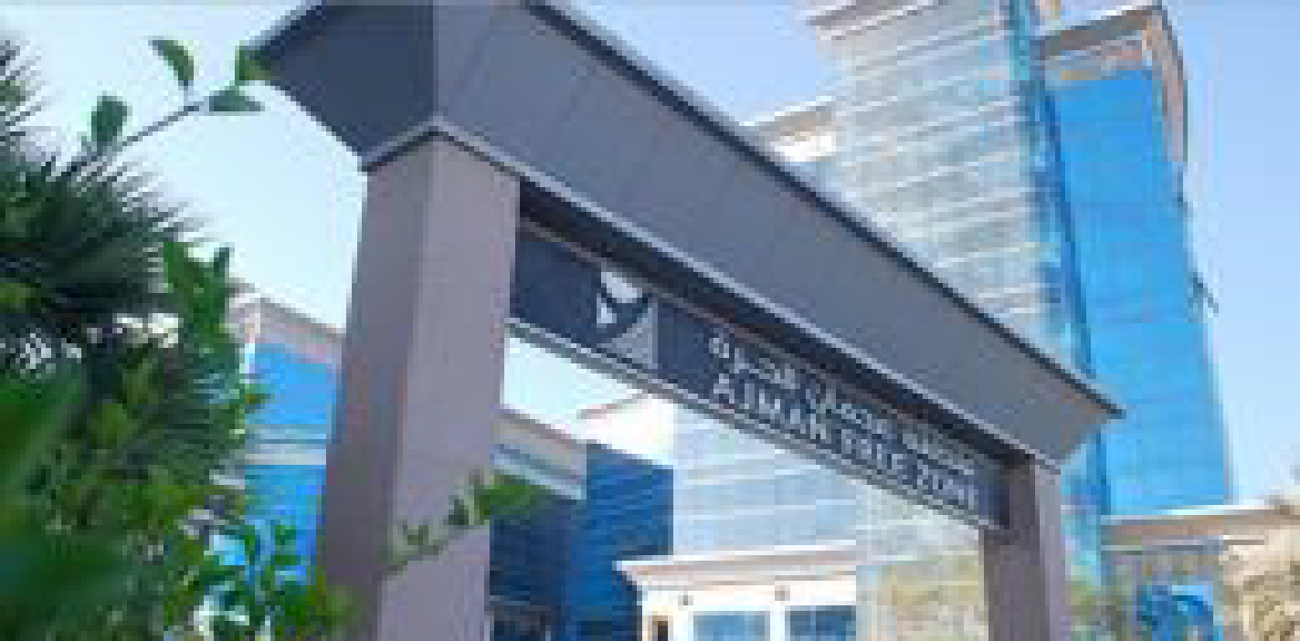
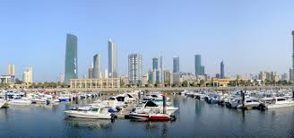
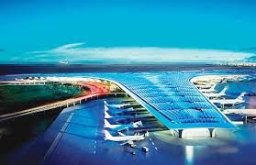
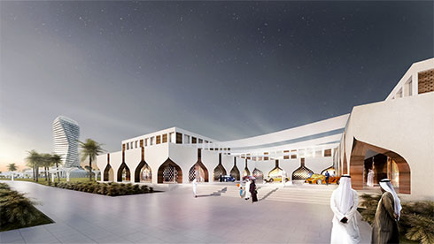
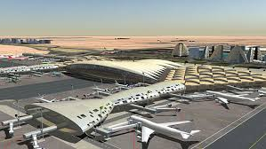
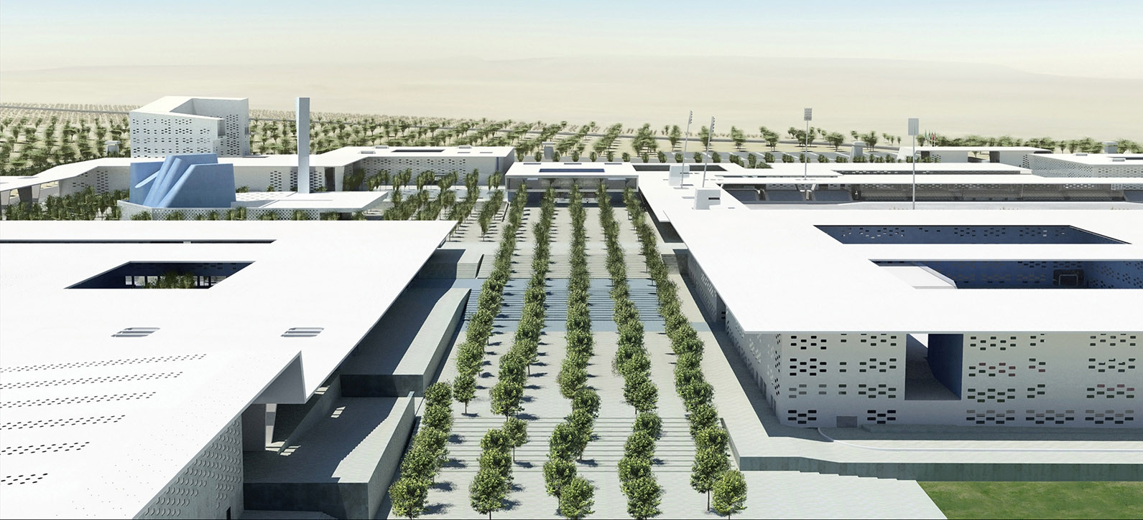
Projects with
BSTsecurity
Designed Solutions
International references
Ministry Council Building Kuwait “Twin Tower”.
KMT (Kuwait Motor town)
AlShaab retail complex (Kuwait)
Kuwait Airport T2 and T4 VIP section
Riyad Municipality
KSA MOT HQ. Riyadh (Ministry of telecom)
Riyad Airport (customs section)
Lusail Luxurious complex “Blusail” (Qatar)
SeaPort Offices (Qatar)
Ajman Free Zone Towers (AFZA)
Daman Towers and Hotel (DIFC) Dubai, UAE
Multiple UN bases (Africa)
Field Hospitals for WHO
Tampo Luxury Residential compound (South Africa)

Slide 18
For more information contact us:
Tel: 514 447 8282
bst@bstsecurity.com
www.bstsecurity.com
17550 Route Trans Canadienne, Kirkland, Quebec, Canada H9J 3A3

